Slide 1

21CSS101J-PROGRAMMING FOR PROBLEM SOLVING Unit I
SRM UNIVERSITY
Institute of Science and Technology,
Chennai

Slide 2
COURSE LEARNING RATIONALE (CLR) | The purpose of learning this course is to:
CLR-1: | Think and evolve with a logic to construct an algorithm and pseudocode that can be converted into a program
CLR-2 : | Utilize the appropriate operators and control statements to solve engineering problems
CLR-3 : | Store and retrieve data in a single and multidimensional array
CLR-4 : | Create custom designed functions to perform repetitive tasks in any application
CLR-5 : | Create basic Abstract Data Types with python
CLR-6 : | Create applications using suitable python library functions for solving datascience problems

Slide 3
Course Learning Outcomes (CLO) | At the end of this course, learners will be able
CLO-1: | To solve problems through computer programming. Express the basic data types and variables in C
CLO-2: | To use appropriate data types in simple data processing applications. To create programs using the concept of arrays
CLO-3: | To create string processing applications with single and multi-dimensional arrays
CLO-4: | To create user defined functions with required operations. To implement pointers in applications with dynamic memory requirements.
CLO-5: | To create programs using the python data types, loops, control statements for problem solving
CLO-6: | To implement the suitable python library based solutions for solving statistical problems in data science

Slide 4
Unit-1 Evolution of Programming & Languages - Problem solving through programming - Writing algorithms & Pseudo code - Single line and multiline comments - Introduction to C: Structure of the C program - Input and output statements. Variables and identifiers, Constants, Keywords - Values, Names, Scope, Binding, Storage Classes - Numeric Data types: integer, floating point
Non-Numeric Data types: char and string - L value and R value in expression, Increment and decrement operator - Comma, Arrow and Assignment operator, Bitwise and Size-of operator - Arithmetic, Relational and logical Operators - Condition Operators, Operator Precedence - Expressions with pre / post increment operator

Slide 5
Debugging
To debug a program or hardware device is to start with a problem, isolate the source of the problem, and then fix it.
Process of identifying, isolating and correcting the errors Two Categories –
Syntax errors -- Errors in spelling and grammar.
You can use the compiler or interpreter to uncover syntax errors.
You must have a good working knowledge of error messages to discover the cause of the error.
Example: C line -> printf(“Hello!”)
Logical errors -- Errors that indicate the logic used when coding the program failed to solve the problem.
You do not get error messages with logic errors.
Your only clue to the existence of logic errors is the production of wrong solutions.

Slide 6
Testing
Checking of desired results
Generate Test cases
Objective is to find a case where program fails
Two Types –
Black Box (Functional) –
This is a method of software testing that examines the functionality of an software or program (e.g. what the software does) without peering into its internal structures or workings.
White Box (Glass Box) –
This a method of testing software that tests internal structures or workings of an application
In white-box testing an internal perspective of the system, as well as programming skills, are used to design test cases.

Slide 7
System Software
System Software includes the Operating System and all the utilities that enable the computer to function.
System software is a term referring to any computer software which manages and controls the hardware so that application software can perform a task.
Example:
Operating Systems, Compiler, Loader, Linker, Interpreter.

Slide 8
System Software: Operating System
An operating system (OS) is software that manages computer hardware and software resources and provides common services for computer programs.
The operating system is an essential component of the system software in a computer system. Application programs usually require an operating system to function.
OS acts as an interface between the application programs and the machine hardware.
Examples: Windows, Linux, Unix and Mac OS, etc.,

Slide 9
System Software (contd):
Compiler: A compiler is a computer program (or set of programs) that transforms source code written in a programming language (the source language) into another computer language (the target language, often having a binary form known as object code).
The name "compiler" is primarily used for programs that translate source code from a high-level programming language to a lower level language (e.g. assembly language or machine code).
cross-compiler :If the compiled program can run on a computer whose CPU or operating system is different from the one on which the compiler runs, the compiler is known as a cross-compiler.
Decompiler : A program that translates from a low level language to a higher level one is a decompiler.
Transpiler or Translator: A program that translates between high- level languages is usually called a source-to-source compiler or transpiler.

Slide 10
System Software (contd):
Loader: A loader is the part of an operating system that is responsible for loading programs into memory, preparing them for execution and then executing them.
The loader is usually a part of the operating system's and usually is loaded at system boot time and stays in memory until the system is rebooted, shut down, or powered off

Slide 11
System Software (contd):
Linker: A linker or link editor is a program that takes one or more objects generated by compilers and assembles them into a single executable program.
Linker may be a part of compiler.
Linkers can take objects from a collection called a library. The objects are program modules containing machine code and information for the linker.
Object File
Executable file
Linker
C library file

Slide 12
System Software (contd):
Interpreter: An interpreter is a computer program that translates and executes instructions written in a computer programming language line-by- line, unit by unit etc.,
An interpreter needs to be able to analyze instructions written in the source language.
Assembler
Converts assembly language programs into object files

Slide 13
Object file and Executable file
An object file is a file containing object code, meaning relocatable format machine code that is usually not directly executable.
Object file has .o extension e.g. hello.o
Object files are produced by an assembler, compiler, or other language translator, and used as input to the linker, which in turn typically generates an executable file.
An executable file is formed by linking the Object files and has .exe extension.
Object file contains low level instructions which can be understood by the CPU. That is why it is also called machine code.

Slide 14
Difference between Object file and Executable file :
Both are binary files but the differences between those are:-
we can execute an executable file while we cannot execute an object file.
An object file is a file where compiler has not yet linked to the libraries, so you get an object file just before linking to the libraries, so still some of the symbols or function definitions are not yet resolved which are actually present in the libraries, and that's why we cannot execute it.

Slide 15
Difference between Interpreter and Compiler
Interpreter | Compiler
Translates program one statement at a time. | Scans the entire program and translates it as a whole into machine code.
It takes less amount of time to analyze the source code but the overall execution time is slower. | It takes large amount of time to analyze the source code but the overall execution time is comparatively faster.
No intermediate object code is generated, hence are memory efficient | Generates intermediate object code which further requires linking, hence requires more memory.
Continues translating the program until the first error is met, in which case it stops. Hence debugging is easy. | It generates the error message only after scanning the whole program. Hence debugging is comparatively hard.
Programming language like Python, Ruby use interpreters. | Programming language like C, C++ use compilers.

Slide 16
What is Programming Language
An artificial language used to write instructions that can be translated into machine language and then executed by a computer.
English and other natural languages are not used as programming languages because they cannot be easily translated into machine language.
Examples: C, C++,Java, Pascal,Python etc

Slide 17
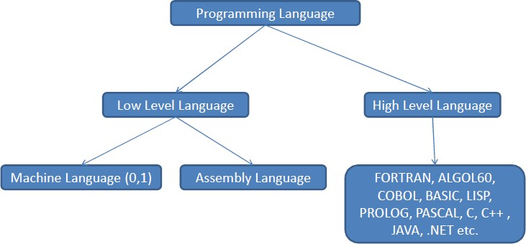
Classification of Programming Languages

Slide 18
The Evolution of Programming Languages -
First Generation(Low Level Language):
The first generation program language is pure machine code, that is just ones and zeros e.g. 010110101110,
Machine Language is the only language that is directly understood by the computer.
Programmers have to design their code by hand then transfer it to a computer by using a punch card.
There is no need to translate the code and it will run straight away.
There are benefits:
Code can be fast and efficient because no translator needed.
Code can make use of specific processor features such as special registers
Drawbacks:
Code cannot be ported to other systems and has to be rewritten
Code is difficult to edit and update
It is difficult to debug the program.

Slide 19
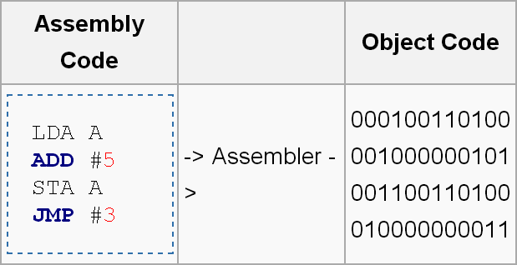
The Evolution of Programming Languages -
Second Generation (Low Level Language):
As you can imagine, writing in 1s and 0s all day will leave you prone to mistakes. Second-generation programming languages are a way of describing Assembly code which uses mnemonic codes like ADD,SUB,MUL,Div,MOV etc.
By using codes resembling English programming becomes much easier. The use of these mnemonic codes such as LDA for load and STA for store means the code is easier to read and write.
To convert an assembly code program into object code to run on a computer requires an Assembler and each line of assembly can be replaced by the equivalent one line of object (machine) code:

Slide 20
Evolution -Cont’d
Advantages of Assembly Language:
Code can be fast and efficient
Code can make use of specific processor features such as Special Registers
As it is closer to plain English, it is easier to read and write when compared to machine code.
Drawbacks:
Code cannot be ported to other systems and has to be rewritten because each processor has their own mnemonics.
No Symbolic names for memory locations. You need to keep track of the exact memory location that a piece of data is stored. That is, you must manipulate memory locations directly.

Slide 21
Third generation (High Level Languages)
Even though Assembly code is easier to read than machine code, it is still not straightforward to perform loops and conditionals .
Third-generation programming languages brought many programmer- friendly features to code such as loops, conditionals, classes etc.
This means that one line of third generation code can produce many lines of object (machine) code, saving a lot of time when writing programs.
Third generation languages can be platform independent, meaning that code written for one system will work on another. To convert a 3rd generation program into object code requires a Compiler or an Interpreter.

Slide 22
Third generation (High Level Languages) – Cont’d
FORTRAN – Stands for FORmula TRANslator is developed in 1957 by John Backus
Very easy to handle complex numbers & Syntax was very difficult to remember
BASIC – Stands for Beginner’s All purpose Symbolic Instruction Code developed in 1960
This language use interpreter during execution of program & Execution slower than FORTRAN programs
COBOL – Stands for COmmon Business Oriented Language developed in 1960
Revised version in 1974 and then 1984 etc. & First language to use English like statement in programming syntax
PASCAL – Named after Blaise Pascal (Philosopher) in 1970
Specially designed as teaching language & Structured programming language
Platform independent language

Slide 23
Third generation (High Level Languages)
C - Developed in 1972 at AT & T’s Bell Laboratory by Dennis Ritchie called POP
Reliable and Simple language & Powerful language which is used for system programming
Handling of Data types, pointers, variables and file etc. is provided
C++ - Developed in 1979 by Bjarne Stroustrup called as C with Class and C++ in 1983
Extension of C, supports object oriented features and Case sensitive Specially works on Classes and Objects
JAVA – Developed in 1991 by Sun Microsystem called as Oak
In 1995, changes to JAVA Supports object oriented features & Simple and Easy to learn
Safe and Secure language
Portable and Platform Independent

Slide 24
Third generation (High Level Languages)
Examples: C, C++,Java.
BASIC (Beginners All Purpose Symbolic Instruction Code), FORTRAN (Formula Translation).
PL/I (Programming Language, Version 1). ALGOL (Algorithmic Language).
APL (A Programming Language).
Advantages:
Hardware independence, can be easily ported to other systems and processors
Time saving, programmer friendly, one line of 3rd gen is the equivalent of many lines of 1st and 2nd gen.
Disadvantages:
Code produced might not make the best use of processor specific features unlike 1st and 2nd gen

Slide 25
Fourth generation
The fourth generation programming language or non-procedural language, often abbreviated as 4GL, enables users to access data in a database.
These are very high-level programming languages are often referred to as goal-oriented programming languages because they are usually limited to a very specific application and it might use syntax that is never used in other programming languages.
SQL, NOMAD and FOCUS are examples of fourth generation programming languages.

Slide 26
Fifth generation
The fifth generation programming language or visual programming language, is also known as natural language.
Provides a visual or graphical interface, called a visual programming environment, for creating source codes.
Fifth generation programming allows people to interact with computers without needing any specialized knowledge. People can talk to computers and the voice recognition systems can convert spoken sounds into written words.
The difficulty is the computer still only understands zeros and ones, so a compiler and interpreter must convert the source code into the machine code that the computer can understand.
Fifth-generation languages characteristically consist of English-like words and phrases, thus uses an English like syntax to simplify software development.
Prolog (PROgramming In LOGic )and Mercury are the best known fifth- generation languages.

Slide 27
Fifth generation – Cont’d
Advantages:
Have friendly interfaces
Easier to use than older high level languages 3.Linked to the English language
Disadvantages:
Programs run slower than those of earlier language generations because their machine code is longer and more complex

Slide 28



Phases of C Programs:
Program is created in the editor and stored on disk
Preprocessor program processes the code
Compiler creates object code and stores it on disk.
Linker links the object code with the libraries
Editor
Disk
Edit
Preprocess
Compile
Link
Preprocessor
Disk
Compiler
Disk
Linker
Disk
Primary Memory
Load
Execute
Loader
5. Loader puts program in memory.
Disk
CPU
Primary Memory
6. CPU takes each instruction and executes it, possibly storing new data values as the program executes

Slide 29
Problem Solving through Programming
Problem - Defined as any question, something involving doubt, uncertainty, difficulty, situation whose solution is not immediately obvious
Computer Problem Solving
Understand and apply logic
Success in solving any problem is only possible after we have made the effort to understand the problem at hand
Extract from the problem statement a set of precisely defined tasks

Slide 30
Problem Solving through Programming Cont’d
Creative Thinking
Proven method for approaching a challenge or opportunity in an imaginative way
Process for innovation that helps explore and reframe the problems faced, come up with new, innovative responses and solutions and then take action
It is generative, nonjudgmental and expansive
Thinking creatively, a lists of new ideas are generated
Critical Thinking
Engages a diverse range of intellectual skills and activities that are concerned with evaluating information, our assumptions and our thinking processes in a disciplined way so that we can think and assess information more comprehensively
It is Analytical, Judgmental and Selective
Thinking critically allows a programmer in making choices

Slide 31
Problem Solving through Programming Cont’d
Program - Set of instructions that instructs the computer to do a task
Programming Process
Defining the Problem
Planning the Solution
Coding the Program
Testing the Program
Documenting the Program

Slide 32
Problem Solving through Programming Cont’d
A typical programming task can be divided into two phases:
Problem Solving Phase
Produce an ordered sequence of steps that describe solution of problem this sequence of steps is called an Algorithm
Implementation phase
Implement the program in some programming language
Steps in Problem Solving
Produce a general algorithm (one can use pseudocode)
Refine the algorithm successively to get step by step detailed algorithm that is very close to a computer language
Pseudocode is an artificial and informal language that helps programmers develop algorithms
Pseudocode is very similar to everyday English

Slide 33
Algorithm
An algorithm is a finite set of instructions that if followed, accomplishes a particular task.
An input to an algorithm specifies an instance of the problem.
An algorithm can be specified in a natural language or pseudo code.
Algorithm can be implemented as computer programs.

Slide 34
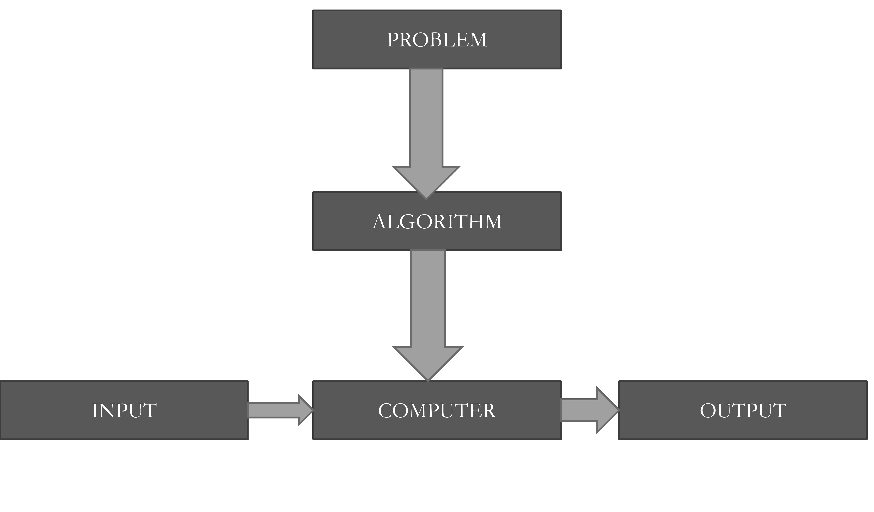
Algorithm Cont’d

Slide 35
Characteristics of Algorithms
INPUT: zero or more quantities externally supplied.
OUTPUT: at least one quantity is produced.
DEFINITENESS: Each instruction is clear and ambiguous.
FINITENESS: the algorithm terminates after a finite number of ps.
EFFICIENCY: every instruction must be very basic.
UNAMBIGUITY: an algorithm must be expressed in a fashion that is completely free for ambiguity.

Slide 36
Design Methods
Understanding the problem.
Ascertaining the capabilities of computational device.
Choosing between exact and approximate problem solving.
Deciding the appropriate data structure.
Algorithm design techniques.
Method of specifying an algorithm.
Proving an algorithm’s correctness.
Analyzing an algorithm.
Coding an algorithm.

Slide 37
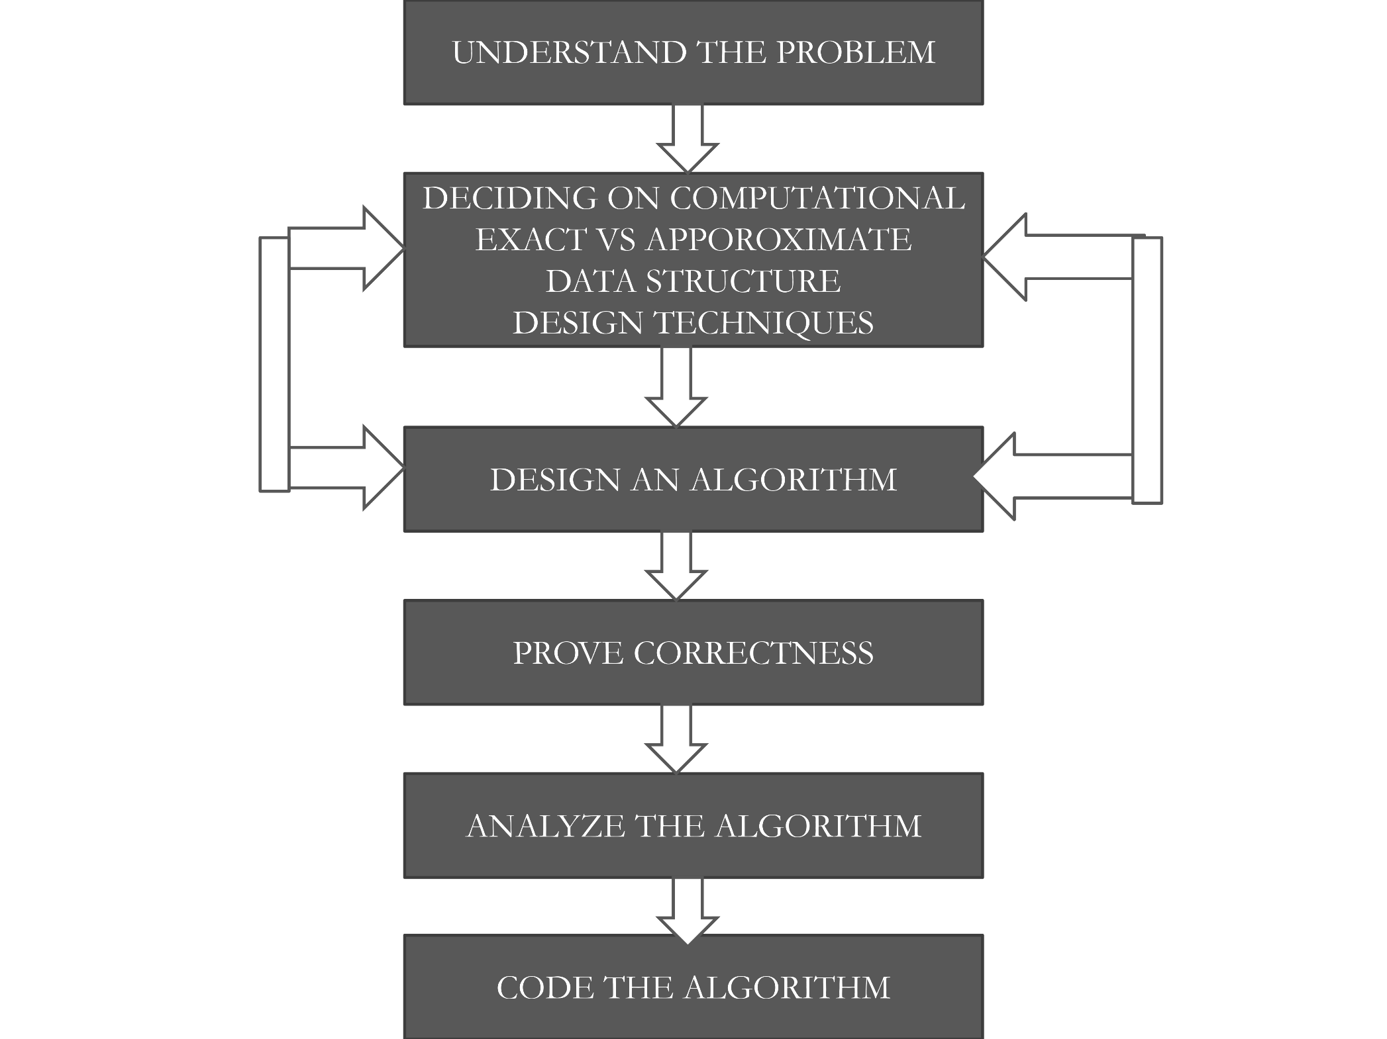
Algorithm Cont’d

Slide 38
1. Understanding the Problems
Reading the problem’s description carefully.
Ask questions and clarify the doubt arise in the problem.
Do some examples and the think about special cases.
Divide the problem into smaller problems until it become manageable size.

Slide 39
2. Ascertaing Capabilities of Computational Device
In random access machine, instruction to be executed one after another, one operation at a time.
Algorithm designed to be executed on such machines are called sequential algorithm.
The central assumption of the RAM model does not called for some new computers that can execute operations concurrently. That is operation executed parallel.
Algorithm that take the advantage of operations that executed concurrently is called parallel algorithm

Slide 40
3. Choosing between exact and approximate problem solving
The next principal decision is to choose between solving the problem exactly or solving the problem approximately.
Exact algorithm: solve the problem exactly .
Appropriate algorithm: solve the problem approximately.
Benefits:
Some problem can not be solved exactly
- extracting square root
- solving non linear equations
- evaluating definite integrals
Exact algorithm can be slow because of the problem’s complexity

Slide 41
4. Deciding the appropriate data structure
Defined as a particular scheme of organizing related data items.
Algorithm + Data structure = Programs.
Important for both design and analysis of algorithms
Some algorithm do not demand any ingenuity is representing their inputs.
Some of the algorithm design techniques is used to structuring or restricting data specifying a problem’s instance.
The variability is algorithm is due to in which the data of program are stored.

Slide 42
5. Algorithm Design Technique
An algorithm design technique is a general approach to solving problems algorithmically that is applicable to a variety of problems from different areas of computing
Merits:
Provide guidance for designing algorithms for new problem.
Algorithm are the cornerstone of computer science.
Used to classify the algorithm based on the design idea.
Can serve as a natural way to both categorize and study algorithms.

Slide 43
6. Method of Specifying an Algorithm
There are three options that are most widely used for specifying algorithms.
Euclid’s algorithm
Pseudo code
Flow chart
Euclid’s algorithm: specified by simple English statement in step by step form
Flow chart:
It is a method of expressing an algorithm by diagrammatic representation.
It is very simple

Slide 44
Method of Specifying an Algorithm – Cont’d
Pseudocode
It is a mixture of natural language and programming language constructs.
It is move precise than a natural language.
For simplicity, declaration of the variable omitted.
For, if and while statements are used to show the scope of variables.
“ ← ” is used for assignment operation.
“// ” is used for comments

Slide 45
7. Proving an algorithm’s correctness
Once an algorithm has been specified, then its correctness must be proved.
The algorithm yields a required result for every legitimate input in a finite amount of time.
Proving correctness - mathematical induction. ▪ In mathematical induction an algorithms iteration provide a natural sequence of steps needs for proofs.
The notation of correctness for approximation is less straight forward than it is for exact algorithm

Slide 46
8. Analyzing algorithms
Efficiency of an algorithm can be measured in terms of space and time.
Space: The number of units, it requires for memory storage.
Time: The amount of time needed for executing an algorithm.
Complexity of an algorithm is measured by calculating the time taken, space required for performing the algorithm.

Slide 47
9. Coding an Algorithm
Once an algorithm has been selected, a 10-506 speed up may be worth an effort.
An algorithm’s optimally is not about the efficiency of an algorithm but about the complexity of the problem.
Another important issue of algorithmic problem solving is the question of whether or not every problem can be solved by algorithm.

Slide 48
Writing Pseudocodes
Pseudocode is an artificial and informal language that helps programmers develop algorithms. Pseudocode is a "text-based" detail (algorithmic) design tool.
All statements showing "dependency" are to be indented.
Given record/file descriptions
Pseudocode should be created in sufficient detail so as to directly support the programming effort
It is the purpose of pseudocode to elaborate on the algorithmic detail and not just cite an abstraction

Slide 49
Writing Pseudocodes – Cont’d
For looping and selection, The keywords that are to be used include
Do While...EndDo;
Do Until...Enddo;
While .... Endwhile
Loop .... endloop
Case...EndCase
If...Endif
Call ... with (parameters)
Call; Return
Return
When

Slide 50
Writing Pseudocodes – Cont’d
The pseudocode entries are to be cryptic, AND SHOULD NOT BE PROSE. NO SENTENCES.
Do not include data declarations in your pseudocode
But do cite variables that are initialized as part of their declarations. E.g. "initialize count to zero" is a good entry.
INDENTATION in pseudocode should be identical to implementation in a programming language.
Try to indent at least four spaces.

Slide 51
Example:
initialize passes to zero
initialize failures to zero
initialize student to one
while student counter is less than or equal to ten
input the next exam result
if the student passed
add one to passes
else
add one to failures
add one to student counter
endif
endwhile
print the number of passes
print the number of failures
if eight or more students passed
print "raise tuition"
endif

Slide 52
Introduction to C – Token
A token is an atomic unit (smallest indivisible units) in a program.
The most basic elements in a C program recognized by the compiler are a single character or a group of characters called C tokens.
The compiler cannot breakdown the token any further. For example, the words main, ‘{‘ (brace), ‘}’ (parenthesis) are all tokens of C program.

Slide 53
Types of Tokens
Keywords
Eg. float , int, double, while, for
Identifiers
Eg. main, amount
Constants
Eg. 12.4, 7894
Special Symbols
Eg. [, ], {, }, (, )
Operators
Eg. + , * , /

Slide 54
Character Set
The C character set includes the upper case letters A to Z, the lower case a to z, the decimal digits 0 to 9 and certain special characters.
Letters – a, b, c, d, …. , z
Digits – 0, 1, 2, 3, 4, 5, 6, 7, 8, 9
Special Characters - ~ , . ; : ? ‘ “ ! ( ) [ ] { } / \ < > = + - $ # @ & * % ^

Slide 55
Identifiers
Identifiers are distinct names given to program elements such as constants, variables, etc.
An Identifier is a sequence of letters, digits, and the special character ‘_’ (underscore).
It must start with either a letter or underscore ‘_’
No commas or blanks are allowed within a variable name.
The upper case and lower case letters are treated as distinct, i.e., identifiers are case-sensitive.
An identifier can be of any length.
No special symbol can be used in a variable name

Slide 56
Keywords
Keywords are predefined tokens in C. These are also called reserved words.
Key words have special meaning to the C compiler.
These key words can be used only for their intended action; they cannot be used for any other purpose.
C has 32 keywords
auto | break | case | char | struct | switch
const | continue | default | do | union | typedef
double | else | enum | extern | unsigned | void
float | for | goto | if | volatile | while
int | long | register | return | sizeof | static
short | signed

Slide 57
Data Types
A data type defines a set of values and the operations that can be performed on them.
Every datatype item (constant, variable etc.) in a C program has a datatype associated with it. C also has a special.
C also has a special datatype called void, which, indicates that any data type, i.e., no data type, does not describe the data items.

Slide 58
Data Types – Cont’d
Data types | Description | Size (No. of Bytes) | Range
Char | Single character | 1 | 0 to 255
Int | An integer | 2 | -32768 to +32767
Float | Floating point number | 4 | -2,147,483,648 to +2,147,483,647
Double | Floating point number | 8 | Approximately 15 digits of Precision
Void | No data type | 0
Signed char | Character | 1 | -128 to 127
Unsigned char | Unsigned Character | 1 | 0 to 255
Short signed int | Short signed integer | 2 | -32768 to +32767
Short unsigned int | Short unsigned integer | 3 | 0 to 65535
Long signed int | Long signed integer | 4 | -2,147,483,648 to +2,147,483,647

Slide 59
Constants and Variables
A constant is a literal, which remain unchanged during the execution of a program.
A constant is a fixed value that cannot be altered during the execution of a program.
C constants can be classified into two categories.
Primary Constants
Secondary Constants

Slide 60
Rules for constructing Integer constants
An integer constant must have at least one digit.
It should not contain either a decimal point or exponent.
If a constant is positive, it may or may not be preceded by a plus sign. If it is a negative, it must be preceded by a minus sign.
Commas, blanks and non-digit characters are not allowed in integer constants.
The value of integer constant cannot exceed specified limits. The valid range is –32768 to +32767.

Slide 61
Real Constants
Real values are often called floating-point constants. There are two ways to represent a real constant decimal form and exponential form.
In exponential form of representation, the real constant is represented in two parts. The part appearing before ‘e’ is called mantissa, whereas the part following ‘e’ is called exponent.

Slide 62
Rules of Constructing Real Constants
The mantissa part and the exponential part should be separated by a letter e.
The mantissa part may have a positive or negative sign.
Default sign of mantissa part is positive.
The exponent must have at least one digit, which must be a positive or negative integer. Default sign is positive.
Range of real constants expressed in exponential form is - 3.4e38 to 3.4e38

Slide 63
Rules for Constructing Characters
A character constant is a single alphabet, a single digit or a single special symbol enclosed within single inverted commas. Both the inverted commas point to the left. For example, ‘A’ is valid character constant whereas A is not.
The maximum length of a character constant can be 1 character.
Note: Every character has its ASCII (American Standard Code for Information Interchange) value. That means every character is interchange with integer constant. For example, ‘A’ value is 65 and ‘a’ value is 97

Slide 64
String Constants
A string constant is a sequence of characters enclosed in double quotes. The characters may be letters, numbers, blank space or special characters.
Note that “” is null string or empty string. And the single string constant “A” is not equivalent to the single character constant ‘A’
Each string constant must end with a special character ‘\o’. This character is called null character and used to terminate the string. The compiler automatically places a null character at the end of every string constant.

Slide 65
Escape Sequence
Some non-printing characters and some other characters such as double quote (“), single quote (“), question mark (?) and backslash (\), require an escape sequence. A list of commonly used backslash character constants is given below.
Escape Sequence | Meaning | ASCII Value | Escape Sequence | Meaning | ASCII Value
\a | Bell | 7 | \r | Carriage Return | 13
\b | Back Space | 8 | \” | Double Quote | 34
\t | Tab | 9 | \’ | Single Quote | 39
\n | New Line | 10 | \? | Question Mark | 63
\v | Vertical Tab | 11 | \o | Null | 0
\f | Form Feed | 12 | \\ | Back Slash | 62

Slide 66
Variables
A variable can be considered as a name given to the location in memory.
The term variable is used to denote any value that is referred to a name instead of explicit value.
A variable is able to hold different values during execution of a program, where as a constant is restricted to just one value.
For example, in the equation 2x + 3y = 10; since x and y can change, they are variables, whereas 2,3 and 10 cannot change, hence they are constants. The total equation is known as expression.

Slide 67
Rules for Constructing Variables Names
The name of a variable is composed of one to several characters, the first of which must be a letter.
No special characters other than letters, digits, and underscore can be used in variable name.
Some compilers permit underscore as the first character.
Commas or Blanks are not allowed with in a variable name.
Upper case and Lower case letters are significant. That is the variable “income” is not same as “INCOME”.
The variable name should not be a C key word. Also it should not have the same name as a function that is written either by user or already exist in the C library.

Slide 68
C Instructions
There are basically four types of instructions in C:
Type Declaration Instruction: to declare the type of variables used in a C program
Input/Output Instruction: To perform the function of supplying input data to a program and obtaining the output results from it.
Arithmetic Instruction: To perform arithmetic operations between constants and variables.
Control Instruction: To control the sequence of execution of various statements in a C program.

Slide 69
Operators & Expressions
An operator is a symbol that tells the computer to perform certain mathematical or logical manipulations.
Operators are used in program to manipulate data and variables. The data items that operators act upon are called operands.
Some operators require two operands, while others act upon only one operand. The operators are classified into unary, binary and ternary depending on whether they operate on one, two or three operands respectively.

Slide 70
Types of Operators
C has four classes of operators:
Arithmetic Operators
Relational Operators
Logical Operators
Bit-wise Operators
In addition, C has some special operators, which are unique to C, they are
Increment & Decrement Operators
Conditional Operators
Assignment Operators, etc.

Slide 71
Arithmetic Operators
There are five arithmetic operators in C.
The following table lists the arithmetic operators allowed in C
Operator | Meaning
+ | Addition
- | Subtraction; also for unary Minu
* | Multiplication
/ | Division
% | Modulo Division (Remainder after integer division)

Slide 72
Relational Operators
Relational Operators are symbols that are used to test the relationship between two variables or between a variable and a constant. We often compare two quantities, and depending on their relation takes certain decisions. These comparisons can be done with the help of relational operators.
C has six relational operators as shown below.
Operator | Meaning
> | Greater than
>= | Greater than or Equal to
< | Less than
<= | Less than or Equal to
== | Equal to
!= | Not Equal

Slide 73
Logical Operators
Logical Operators are symbols that are used to combine or negate expressions containing relational operators.
C has three logical operators as defined below.
Operator | Meaning
&& | Logical AND
|| | Logical OR
! | Logical NOT

Slide 74
Bitwise Operators
The lowest logical element in the memory is bit. C allows the programmer to interact directly with the hardware of a particular system through bitwise operators and expression.
These operators work only with int and char datatypes and cannot be used with float and double type.
The following table shows the bitwise operators that are available in C
Operator | Meaning
- | One’s Complement
| | Bitwise OR
& | Bitwise AND
^ | Bitwise Exclusive OR (XOR)
>> | Right Shift
<< | Left Shift

Slide 75
Increment & Decrement operators
C has two very useful operators for adding and subtracting a variable. These are the increment and decrement operators, ++ and -- .
These two operators are unary operators.
The increment operator ++ adds 1 to its operand, and the decrement operator -- subtracts 1 from its operand. Therefore, the following are equivalent operations.
++i is equivalent to i = i + 1;
--i is equivalent to i = i – 1;
These operators are very useful in loops.

Slide 76
Assignment Operators
In addition to usual assignment operator =, C has a set of shorthand operators, that simplifies the coding of a certain type of assignment statement.
It is of the form
var op = exp
where var is a variable, op is a C binary arithmetic operator and exp is an expression
Statement | Equivalent Statement
a += b | a = a + b
a -= b | a = a – b
a *= b | a = a*b
a *= b + c | a = a * (b + c)
a %= b | a = a % b
a *= a | a = a * a

Slide 77
Conditional Operator
C provides a peculiar operator ? : which is useful in reducing the code. It is ternary operator requiring three operands.
The general format is
exp1 ? exp2 : exp3;
where exp1, exp2 and exp3 are expressions.
In the above conditional expression, exp1 is evaluated first. If the value of exp1 is non zero (true), then the value returned will be exp2. if the value of exp1 is zero (false), then the value returned will be exp3.

Slide 78
Hierarchy (precedence) of operators
The priority or precedence in which the operations of an arithmetic statement are performed is called the hierarchy of operators.
The operators of at the higher level of precedence are evaluated first. The operators of the same precedence are evaluated either from left to right or from right to left, depending on the level. This is known as the Associativity property of an operator.
Operator | Description | Associativity | Rank
* | Multiplication | Left to Right | 3
/ | Division | Left to Right | 3
% | Modulo | Left to Right | 3
+ | Addition | Left to Right | 4
- | Subtraction | Left to Right | 4

